Slide 1
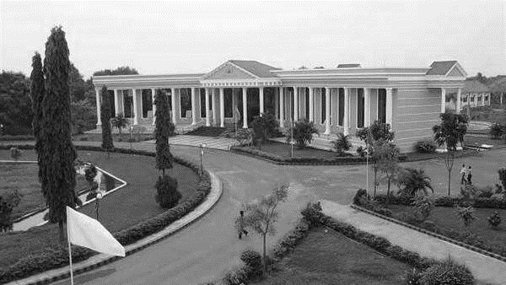



DEEP LEARNING-BASED E-VOTING SYSTEM FOR FRAUD DETECTION
Under the guidance of,
Mrs.V.MAHESWARI,M.C.A.,M.Phil.
ASSISTANT PROFESSOR,CSE
ARUNAI ENGINEERING COLLEGE.
Presented By:
1.SARMA.S(510420104089)
2.RAFFI.A(510420104075)
3.VIGNESH.K(510420104109)
4.MADAN RAJ.B(510420104057)
DEPARTMENT OF
CSE

Slide 2
OVERVIEW
ABSTRACT
INTRODUCTION
OBJECTIVES
E-VOTING SYSTEM
EXISTING SYSTEM
DISADVANTAGES
PROPOSED SYSTEM
ADVANTAGES
ALGORITHM
SYSTEM REQUIREMENTS
ARCHITECTURE DESIGN
MODULES
DIAGRAMMATIC REPRESENTATION OF PROJECT
EXPECTED OUTCOME
CONCLUSION
FUTURE ENHANCEMENT
REFERENCE

Slide 3
ABSTRACT
The primary objective of our system is to enhance the integrity and security of the voting process while ensuring accessibility and transparency. By leveraging biometric authentication methods, we aim to establish a robust framework that minimizes the risks of fraudulent activities such as impersonation and multiple voting.
Key features of our e-voting system include biometric authentication, secure data transmission, comprehensive audit trails, and real-time monitoring capabilities. Through the utilization of advanced encryption techniques, we safeguard the confidentiality and integrity of voting data, thereby fostering trust and confidence among voters.
The scope of our project encompasses the design, development, and testing of a prototype e-voting system, with a focus on demonstrating feasibility and effectiveness.

Slide 4
INTRODUCTION
The primary objective of our system is to enhance the integrity and security of the voting process while ensuring accessibility and transparency.
By leveraging biometric authentication methods, we aim to establish a robust framework that minimizes the risks of fraudulent activities such as impersonation and multiple voting.
Key features of our e-voting system include biometric authentication, secure data transmission, comprehensive audit trails, and real-time monitoring capabilities.
Through the utilization of advanced encryption techniques, we safeguard the confidentiality and integrity of voting data, thereby fostering trust and confidence among voters. The scope of our project encompasses the design, development, and testing of a prototype e-voting system, with a focus on demonstrating feasibility and effectiveness.

Slide 5
OBJECTIVES
Enhanced Security: By utilizing biometric authentication techniques such as face recognition and fingerprint scanning, we aim to bolster the security of the voting system, minimizing the risks of fraudulent activities such as impersonation and multiple voting.
Accuracy and Reliability: Through the implementation of advanced technological solutions, our goal is to enhance the accuracy and reliability of the voting process, thereby fostering trust and confidence among voters.
Accessibility: We strive to develop a user-friendly interface that facilitates ease of use for voters of all demographics, ensuring inclusivity and accessibility.
Transparency: Transparency is a fundamental aspect of any democratic process.

Slide 6
E-VOTING SYSTEM
An e-voting system, short for electronic voting system, is a digital platform or software application designed to facilitate the casting and counting of votes in elections or other decision-making processes. It allows voters to securely and conveniently participate in the electoral process using electronic devices such as computers, tablets, or smartphones, often via the internet.
WHY WE NEED ELECTRONIC VOTING SYSTEM
We need electronic voting systems to enhance accessibility, convenience, efficiency, and security in the electoral process, ultimately fostering higher voter turnout, reducing costs, and improving overall confidence in democratic elections.
Reduce the number of legitimate votes not counted by reducing the number of over-votes,and eliminating vote tampering.
Improve the registration process by allowing voters to check their registration status prior to voting and centralizing databases.
Increases voter confidence and improve the voting experience.

Slide 7
EXISTING SYSTEM
In the existing system, e-voting platforms often face challenges related to security vulnerabilities and fraud risks. Traditional e-voting systems may lack robust mechanisms for ensuring the integrity and confidentiality of votes, making them susceptible to various forms of manipulation, tampering, and fraud.
Moreover, the centralized nature of some e-voting systems raises concerns about single points of failure and potential attacks on the voting infrastructure.
Additionally, issues such as voter authentication, ballot secrecy, and verifiability pose significant challenges in maintaining the trust and credibility of e-voting processes.
Overall, the existing e-voting systems require enhancements to address these shortcomings and establish a secure and transparent electoral framework

Slide 8
DISADVANTAGES
Vulnerabilities to manipulation: Traditional e-voting systems are susceptible to various forms of manipulation and tampering, compromising the integrity of election results.
Lack of robust security measures: Many e-voting platforms lack sufficient security mechanisms to protect against unauthorized access, data breaches, and cyberattacks.
Concerns about transparency and verifiability: The opaque nature of some e-voting systems raises doubts about the transparency and verifiability of election processes, undermining public trust.
Potential for technical failures: Centralized e-voting systems are prone to technical failures, such as system crashes or network outages, which can disrupt voting operations and compromise the accuracy of results.
Legal and regulatory challenges: E-voting systems may face legal and regulatory obstacles, including concerns about privacy, data protection, and compliance with electoral laws and regulations.

Slide 9
PROPOSED SYSTEM
The proposed system for e-voting addresses several shortcomings of existing platforms by introducing enhancements aimed at improving security, transparency, and accessibility.
Key features include the implementation of blockchain technology for enhanced security and transparency of voting records, end-to-end encryption to protect voter data, multi-factor authentication to verify voter identities, and a decentralized architecture to mitigate the risk of cyberattacks and system failures.
Additionally, the proposed system incorporates mechanisms for auditability and verifiability, safeguards voter privacy, and ensures accessibility for all voters.
Overall, the proposed system aims to establish a secure, transparent, and accessible e-voting framework that inspires confidence and trust among stakeholders.

Slide 10
ADVANTAGES
Enhanced Security: The proposed system offers heightened security measures, including blockchain technology and end-to-end encryption, to safeguard voting data and prevent unauthorized access or tampering.
Transparency and Auditability: Utilizing blockchain technology enables transparent and immutable recording of voting transactions, facilitating easy auditability and verification of election results by stakeholders.
Improved Integrity: By eliminating single points of failure through a decentralized architecture, the system enhances the integrity of the voting process and reduces the risk of manipulation or fraud.

Slide 11
ALGORITHM
FACENET ALGORITHM
The FaceNet algorithm is a groundbreaking deep learning model developed by Google researchers for face recognition tasks.
It revolutionizes the field by employing a Convolutional Neural Network (CNN) architecture to extract facial features from input images.
These features are then mapped into a high-dimensional space called a feature space, where the distances between points represent the similarity or dissimilarity between faces.
Key to its success is the triplet loss function, which guides the model during training to learn discriminative embeddings for faces.
By minimizing the distance between embeddings of the same person's face and maximizing the distance between embeddings of different people's faces, FaceNet achieves superior performance in face verification tasks.

Slide 12
SYSTEM REQUIREMENTS
HARDWARE REQUIREMENTS
Processor –Core i3
Hard Disk – 160 GB
Memory – 1GB RAM
Monitor
SOFTWARE REQUIREMENTS
Windows 7 or higher
Python
Pycharm IDE

Slide 13
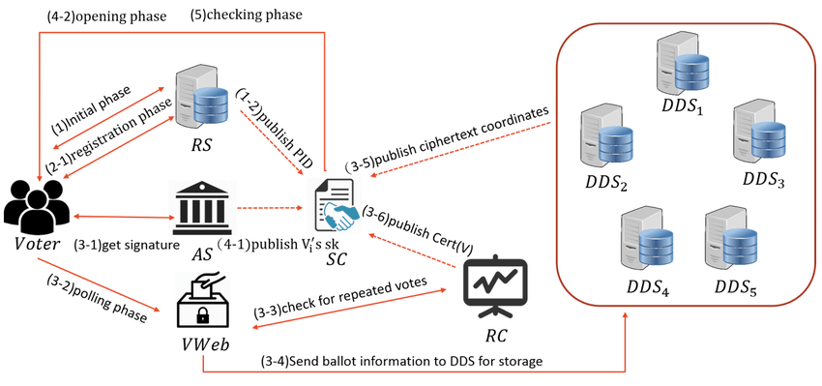
ARCHITECTURE DESIGN

Slide 14
MODULES
PEOPLE MODULE
ADMIN MODULE
FACE RECOGNISE MODULE
FINGERPRINT MODULE

Slide 15
MODULES
PEOPLE MODULE
The people module is a component of a software system designed to manage and organize information about individuals. It typically includes functionalities for storing, retrieving, and updating data related to people, such as their names, contact details, roles, and affiliations. The module may also incorporate features for categorizing people into groups or categories, assigning permissions or access levels, and tracking interactions or activities associated with them. In organizational contexts, the people module is often integrated into larger enterprise resource planning (ERP) or customer relationship management (CRM) systems to facilitate personnel management, collaboration, and communication across departments or teams.
ADMIN MODULE
The admin module is a critical component of software systems, providing administrators with the tools and functionalities necessary to manage various aspects of the system. It enables administrators to oversee user management tasks, including creating, modifying, and deleting user accounts, as well as assigning roles and permissions. Access control features within the admin module allow administrators to define access levels and permissions for different user roles, ensuring proper security measures are in place.

Slide 16
MODULES
FACE RECOGNISE MODULE
The face recognition module is a software component designed to identify and verify individuals based on their facial features. It utilizes computer vision algorithms to analyze facial images and match them against a database of known faces. This module enables applications to authenticate users, provide personalized experiences, and enhance security measures. By detecting unique facial landmarks and patterns, the face recognition module can accurately identify individuals and grant access to authorized users. Additionally, it may incorporate features for face detection, alignment, and feature extraction to improve recognition accuracy.
FINGERPRINT MODULE
The fingerprint module is a software component designed to capture, analyze, and authenticate fingerprint patterns for identification purposes. It utilizes fingerprint recognition technology to extract unique features from a person's fingerprint and match them against stored templates in a database. This module enables applications to verify the identity of individuals with a high level of accuracy, making it a reliable biometric authentication method. By capturing and processing fingerprint images, the fingerprint module can detect minutiae points, ridge patterns, and other distinctive characteristics, allowing for precise matching and authentication. Additionally, it may include features for fingerprint enrollment, template management, and security measures to protect sensitive data.

Slide 17
DIAGRAMMATIC REPRESENTATION OF PROJECT
Registration of user
Checking voter id
Face Scan
User login
Operations
User
Registration
User id
Identification
Not Matched/
Already Voted
Matching
Database
False
True
Fingerprint Scan
Button
Candidates 1
Button
Candidates 2
Voting Results

Slide 18
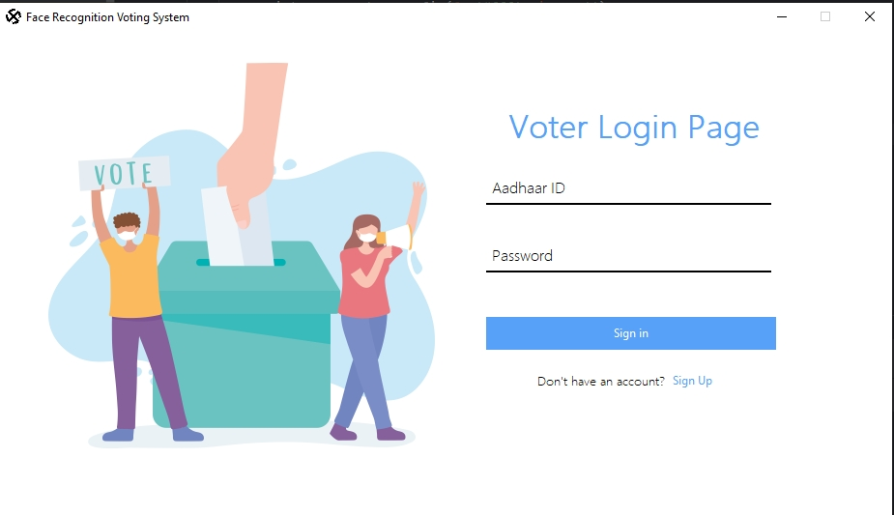
EXPECTED OUTCOME

Slide 19
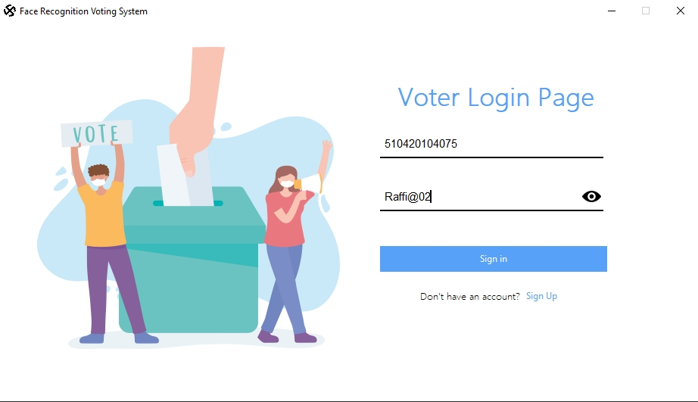
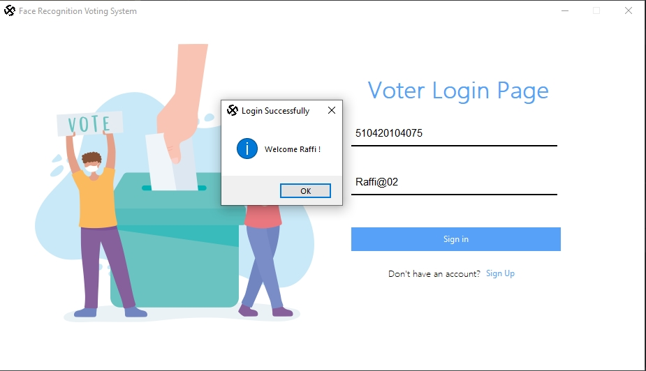

Slide 20
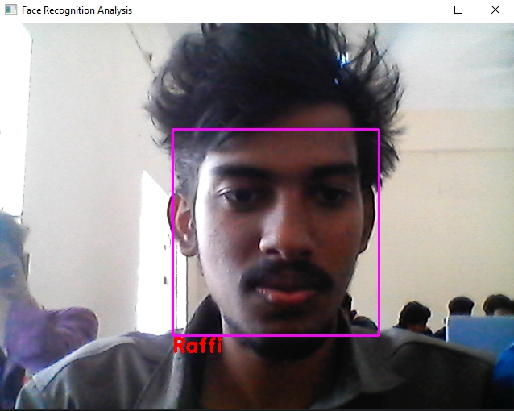
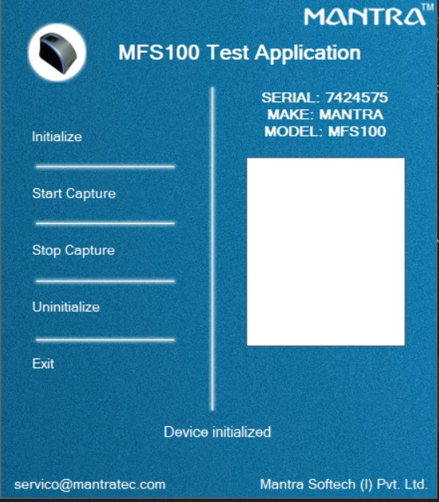

Slide 21
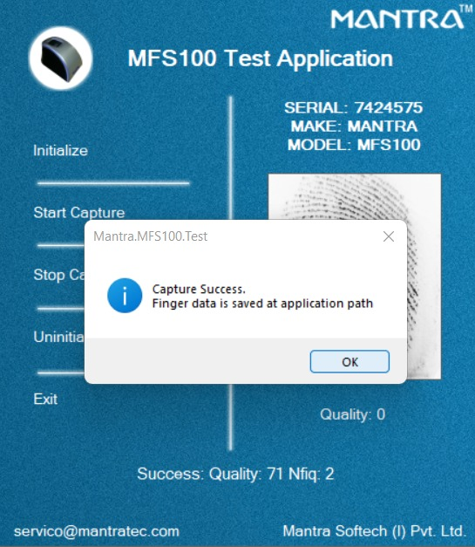
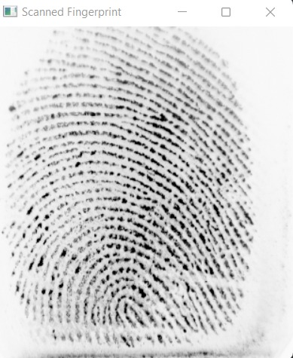

Slide 22
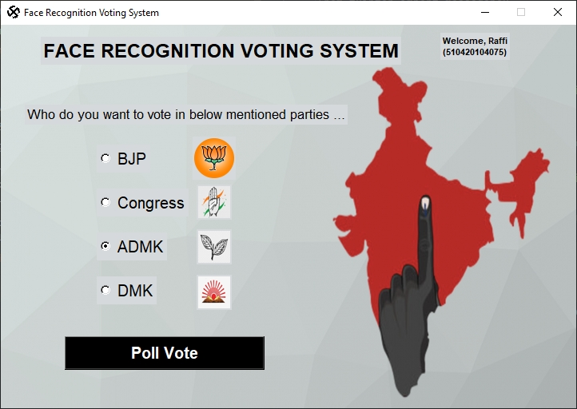

Slide 23
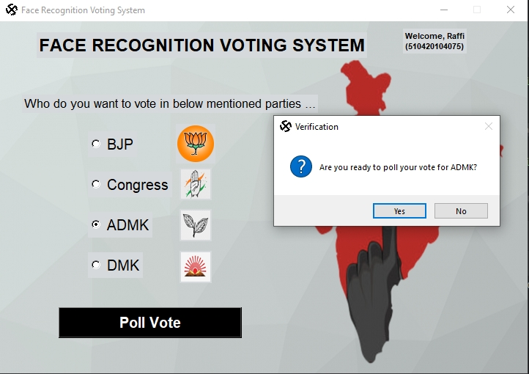
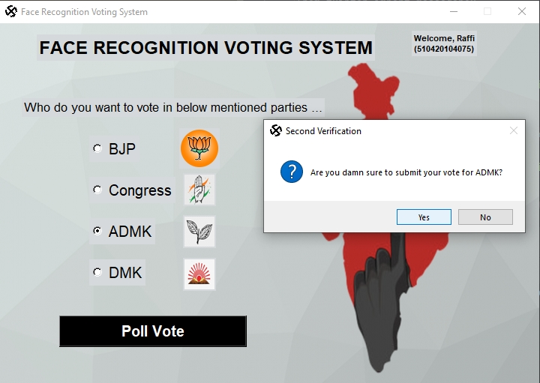

Slide 24
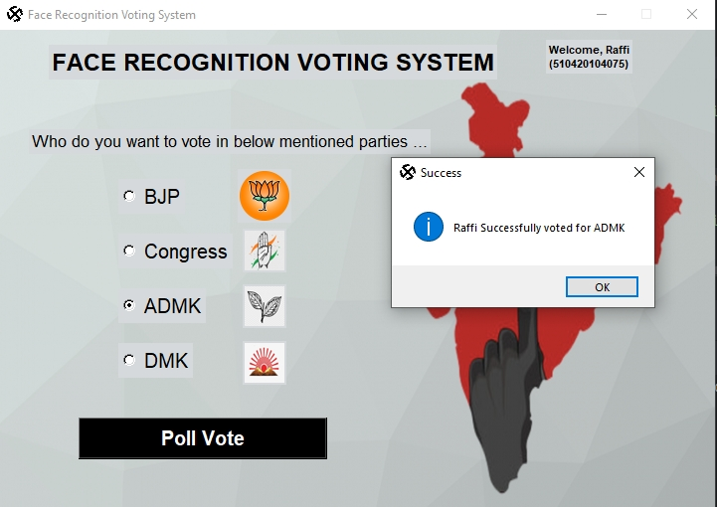

Slide 25

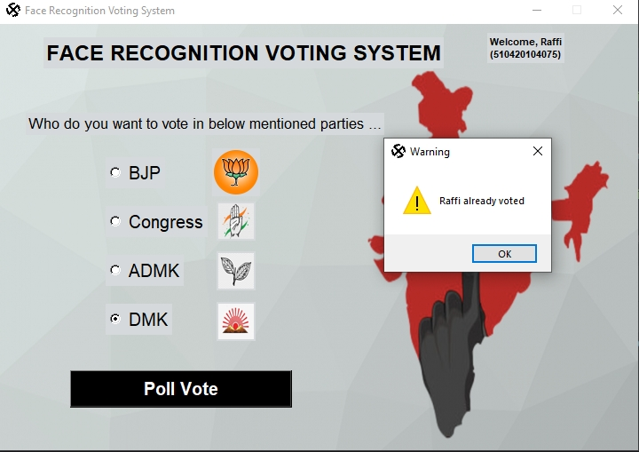

Slide 26
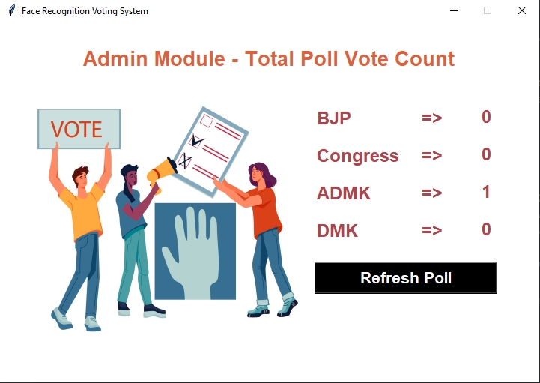

Slide 27
CONCLUSION
A Secure E-voting system uses face recognition and fingerprint methods provide additional security has been discussed in this paper.
As per our study and discussion,Facenet algorithm is superlative for face recognition because it provides high accuracy than other algorithm discussed in paper.
The implemented system focuses on avoiding fake and duplicate voting by providing additional security.
In future system can be built on android platform for online voting using same techniques.
In this project, we have considered only face recognition and fingerprint.
In future, it can be possible to use OTP method for voting.

Slide 28
FUTURE ENHANCEMENT
Future enhancements for an e-voting system to prevent fraud detection encompass various avenues of technological advancement and security reinforcement. Integration of blockchain technology stands out as a paramount enhancement, ensuring transparency, security, and immutability in recording votes. By leveraging blockchain's decentralized ledger, the system can thwart fraudulent activities while providing a verifiable record of each vote. Biometric authentication adds another layer of security, verifying voters' identities through fingerprint or facial recognition to mitigate risks of impersonation or unauthorized access. End-to-end verifiable voting protocols empower voters to independently verify their votes' accuracy without compromising anonymity, bolstering trust in the electoral process. Additionally, homomorphic encryption techniques preserve voter privacy during vote counting, maintaining confidentiality while ensuring accurate tabulation. Multi-factor authentication strengthens voter authentication, requiring multiple forms of verification before casting votes.

Slide 29
REFERENCE
[1] Tadayoshi Kohno, ADAM STUBBLEFIELD,AVIEL D. RUBIN and DAN S. WALLACH,AVIEL D. RUBIN,” Analysis of an Electronic Voting System,2004”.
[2] KashifHussainMemon, Dileep Kumar and Syed Muhammad Usman,” Next Generation A Secure Evoting System Based On Biometric Fingerprint Method, 2011”.
[3] B. Swaminathan, J. Cross Datson Dinesh, “Highly Secure Online Voting System with Multi Security using Biometric and Stegonography, 2012”.
[4] Ashwini Ashok Mandavkar and Rohini Vijay Agawane,” Mobile Based Facial Recognition Using OTP Verification for Voting System, 2015”
[5] Donovan Gentles, Suresh Sankaranarayanan,”
Application of Biometrics in Mobile Voting,2012”.

Slide 30
THANK YOU
DEPARTMENT OF
CSE

